Slide 1

is military spending beneficial or detrimental to a country's economy?
Probability & statistics
Due 23 May, 2022

Slide 2

Team members
Muhammad Faizan – 20k-0366
Yousaf Ahmad Siddiqui – 20k-1664
Haider Ali Khadim – 19k-1080
Ashar – 20k-0364
Umer Hussain – 20k-0346

Slide 3

Abstract/Brief summary
We have selected Pakistan’s Foreign Direct Investment, Number of terrorist attacks, and Military Expenditures as variables in this research.
In this report, we have run the Normal distribution test, spearman’s correlation test on the Terrorism and Foreign Direct Investment time series, and graphical analysis of these three-time series to draw a comparison between them using Python statistical tools.

Slide 4
Objective
In a nutshell, this report comprehends the analysis of Military Expenditures and the Economy of the country through terrorism to visualize the impact of Military Expenditures on the Country’s economy during the last 13 years.

Slide 5
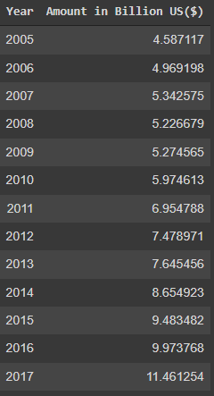
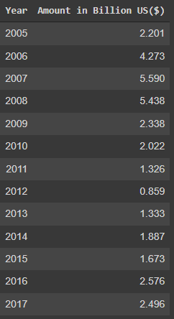
Data collection/methodology
Military Expenditure
Foreign Direct Investment
Data on Military Expenditures and Foreign Direct Investment of Pakistan has been collected from the data.worldbank.org database.

Slide 6
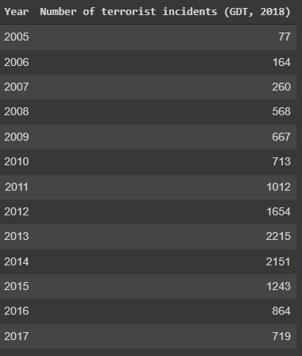
Data collection/methodology
Terrorist Incidents
Data on the Number of terrorist attacks in Pakistan has been collected from the https://ourworldindata.org/ database.
Data sets have been preprocessed in Python, and it has been structured into CSV format.

Slide 7
Descriptive Statistics of Military Expenditures of Pakistan
Objective
The Military Expenditures is time series from 2005 to 2017.
It shows the amount in billion US($) of military expenditures of Pakistan.
We want to describe the summary statistics of this time series.
So, we can determine the highest expenditures and the average expenditures so far.

Slide 8
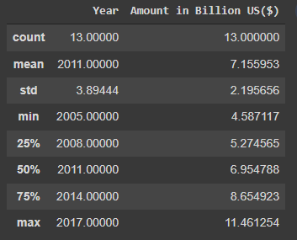
Descriptive Statistics of Military Expenditures of Pakistan
Results

Slide 9
Descriptive Statistics of Military Expenditures of Pakistan
interpretation
The average military expenditure for the last 13 years is 7.155 Billion US($).
And, the highest expenditure is in 2017 which is 11.46 Billion US($).

Slide 10
Descriptive Statistics of Foreign Direct investment of Pakistan
Objective
The Foreign Direct Investment is a time series from 2005 to 2017.
It shows the amount in billion US($) of FDI in Pakistan.
We want to describe the summary statistics of this time series data.
So, we can determine the highest and the average investment so far.

Slide 11
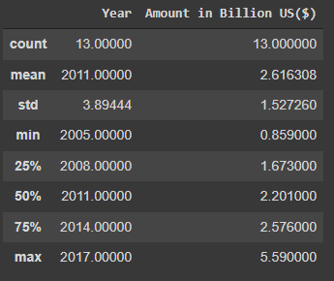
Descriptive Statistics of Foreign Direct investment of Pakistan
results

Slide 12
Descriptive Statistics of Foreign Direct investment of Pakistan
interpretation
The average FDI for the last 13 years in Pakistan is 2.61 Billion US($).
And, the highest FDI is 5.59 Billion US($).

Slide 13
Descriptive Statistics of Terrorist Attacks in Pakistan
objective
The terrorist attacks in Pakistan is a time series from 2005 to 2017.
It shows the number of incidents in the given year.
We want to describe the summary statistics of this time series data.
So, we can determine the highest and the average attacks during the last 13 years.

Slide 14
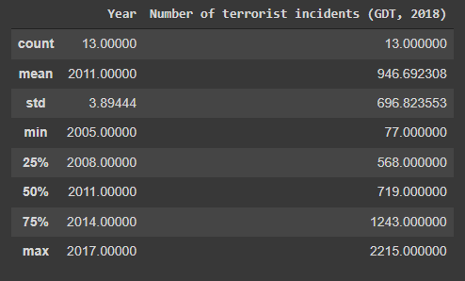
Descriptive Statistics of Terrorist Attacks in Pakistan
results

Slide 15
Descriptive Statistics of Terrorist Attacks in Pakistan
interpretation
On average 947 terrorist attacks occur in a year in Pakistan.
And, the highest number of terrorist incidents is 2215 which occurred in 2013.

Slide 16
Normality test
purpose
In statistics, normality tests are used to determine if a data set is perfectly distributed by a normal distribution, graphically it is a bell-shaped curve.
There are different tests available for evaluating the normal distribution to find out whether the data set follows the normal distribution or not i.e. Histogram-plot, Box-plot, and Q-Q-plot.

Slide 17
Normality test
analysis
We have used Q-Q-plot for the normal distribution test.
Q-Q Plots (Quantile-Quantile plots) are plots of two quantiles against each other. A quantile is a fraction where certain values fall below that quantile.

Slide 18
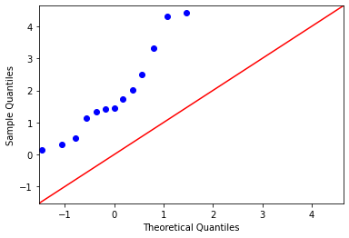
Q-q plot of Terrorist attacks time series
results

Slide 19
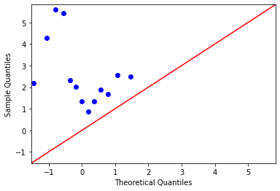
Q-q plot of FDI time series
results

Slide 20
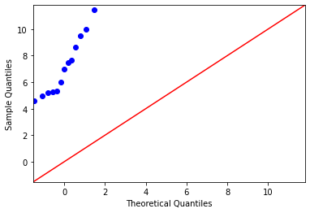
Q-q plot of military expenditures time series
results

Slide 21
Normality test
interpretation
Military Expenditures, Foreign Direct Investment, and terrorist attacks time series do not follow the red 45-degree line on the Q-Q plot which indicates that these three-time series do not have a normal distribution.
Non-normal distribution of data sets implies that we have to use non-parametric tests.

Slide 22
correlation
purpose
Correlation is a statistical technique that shows how strongly two variables are related to each other or the degree of association between the two.
Correlation analysis is used to quantify the degree to which two variables are related.
Through the correlation analysis, you evaluate the correlation coefficient that tells you how much one variable changes when the other one does.
Correlation analysis provides you with a linear relationship between two variables

Slide 23
correlation
analysis
We have used Spearman’s Correlation to produce a sample correlation, which is a non-parametric test that measures the association between two non-normal variables.

Slide 24
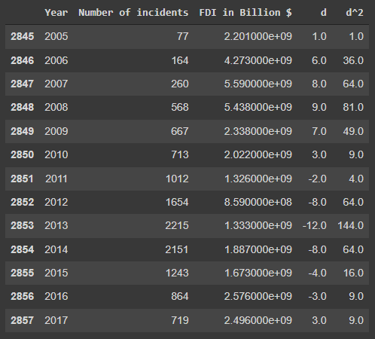
Spearman's correlation between FDI and Terrorism attacks time series
results
First calculated ranks of both the time series and finding “d” which is the difference between the ranks of both time series.
“d^2” is the square of the “d”.
Sum of “d” and “d^2” is 0.0, 550.0.
Spearman correlation value of two-time series using the formula which is below is -0.51.
Spearman correlation = (1-(6*(sum(d^2)))/(n*(n**2-1)))

Slide 25
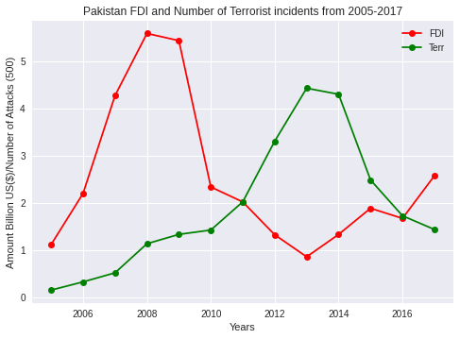
correlation between FDI and Terrorism attacks time series
Correlation through graphical analysis

Slide 26
correlation between FDI and Terrorism attacks time series
interpretation
By analyzing the correlation between FDI and terrorist attacks time series through graphical comparison and spearman’s test.
It is clear that both have a negative correlation i.e. if one series is increasing then the other one will be decreasing.
It means that FDI and terrorism have an inverse relationship.

Slide 27
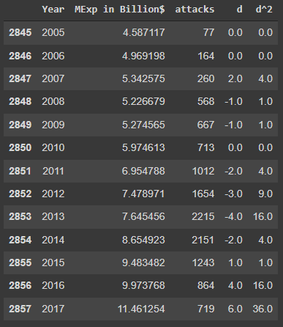
Spearman's correlation between Military Expenditures and Terrorism attacks time series
results
First calculated ranks of both the time series and finding “d” which is the difference between the ranks of both time series.
Sum of “d” and “d^2” is 0.0, 92.0.
Spearman correlation value of two-time series using the formula which is below is 0.75.
Spearman correlation = (1-(6*(sum(d^2)))/(n*(n**2-1)))

Slide 28
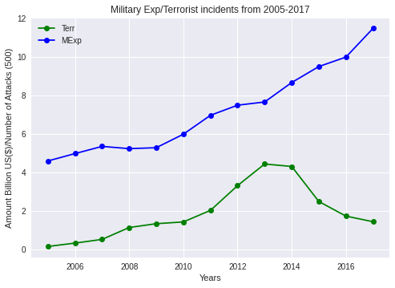
correlation between Military Expenditures and Terrorism attacks time series
Correlation through graphical analysis

Slide 29
correlation between Military Expenditures and Terrorism attacks time series
interpretation
By analyzing the correlation between military expenditures and terrorist attacks time series through graphical comparison and spearman’s test.
It is clear that both have a positive correlation i.e. if one series is increasing then the other one will also increase.

Slide 30

conclusion
In this report, we used different statistical tests i.e. Normality test through Q-Q plot, Spearman’s correlation, and Line plot on the given time series.
According to results, the FDI and terrorism in Pakistan have a negative relationship, and Military expenditures and terrorism have a positive association.
So, this correspondence concludes that if terrorism rises, then military expenditures will also grow up, and ultimately if terrorism will decrease, then FDI growth will escalate.

Slide 31
conclusion
Foreign Direct Investment can foster and maintain economic growth, both in the recipient country and in the country making the investment. It is a critical factor for a country’s economy.
Indirectly, military spending is beneficial for the economic growth of the country.

Slide 32
references
Ajmair et al., 2018
M. Ajmair, K. Hussain, F.A. Abbassi, M. Gohar The impact of military expenditures on economic growth of Pakistan
Appl. Econom. Finance, 5 (2) (2018), pp. 41-48
Dunne, P., and D. Vougas. 1999
Military spending and economic growth in South Africa: A causal analysis. Journal of Conflict Resolution 43 (4): 521–537.
Ando, S. (2009).
The impact of defense expenditure on economic growth: Panel data analysis based on the Feder Model. International Journal of Economic Policy Studies, 4(1), 141–154.
Aziz, N., & Khalid, U. (2019).
Armed Conflict, Military Expenses and FDI Inflow to Developing Countries. Defense and Peace Economics, 30(2), 238â€“251
Sajjad, Tariq, & Tariq, M. . (2017).
The impact of military spending on economic growth of Pakistan. Journal of Applied Economics and Business Studies, 1(1), 53-64.

Slide 33

q/a session
The end

